Slide 1


SQL : Finance Analytics and Supply chain Analytics
DATABASE : MySQL
Analysis on 1.4 Million Records
From CODEBASICS
This Photo by Unknown Author is licensed under CC BY-NC

Slide 2
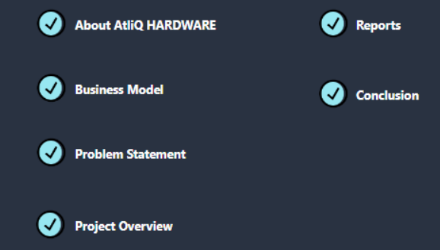
Table of contents

Slide 3
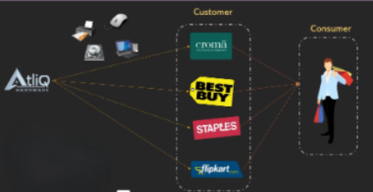
About AtliQ hardware and its Business Model
AtliQ Hardware is a distinguished global leader in electronics manufacturing, specializing in the production and distribution of an extensive range of high-quality hardware products. Our offerings include personal computers, printers, mice, and a variety of other computer peripherals, serving the diverse needs of customers worldwide.

Slide 4
Problem Statement and Project Overview
Problem Statement :
Atliq Hardware is a leading manufacturer of computer hardware in India and other nations, but it struggles to make prompt and wise choices based on data.
Project Overview :
AtliQ Hardware's data analytics project aims to resolve performance problems caused by large Excel files. A team of data analysts will leverage MySQL to extract actionable insights, enabling better decision-making and operational optimization, ultimately enhancing the company's overall performance.

Slide 5
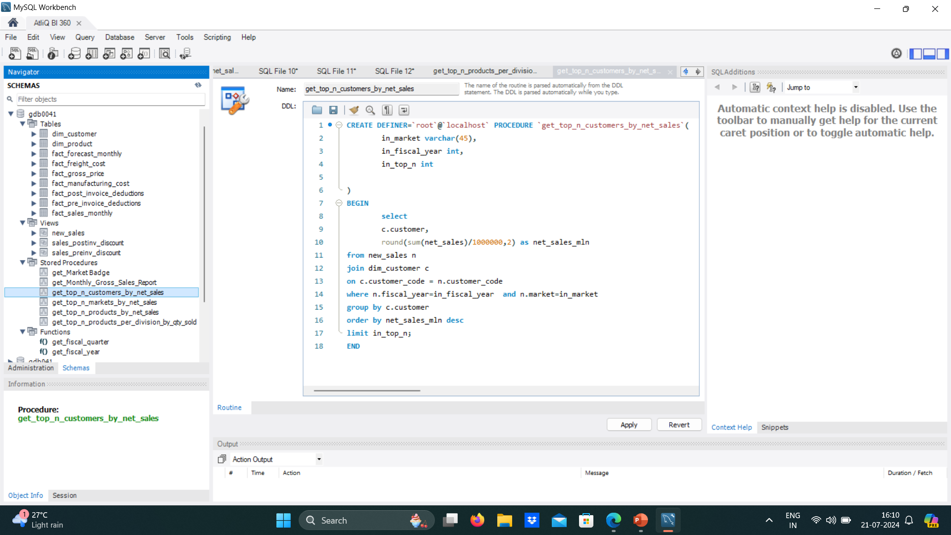
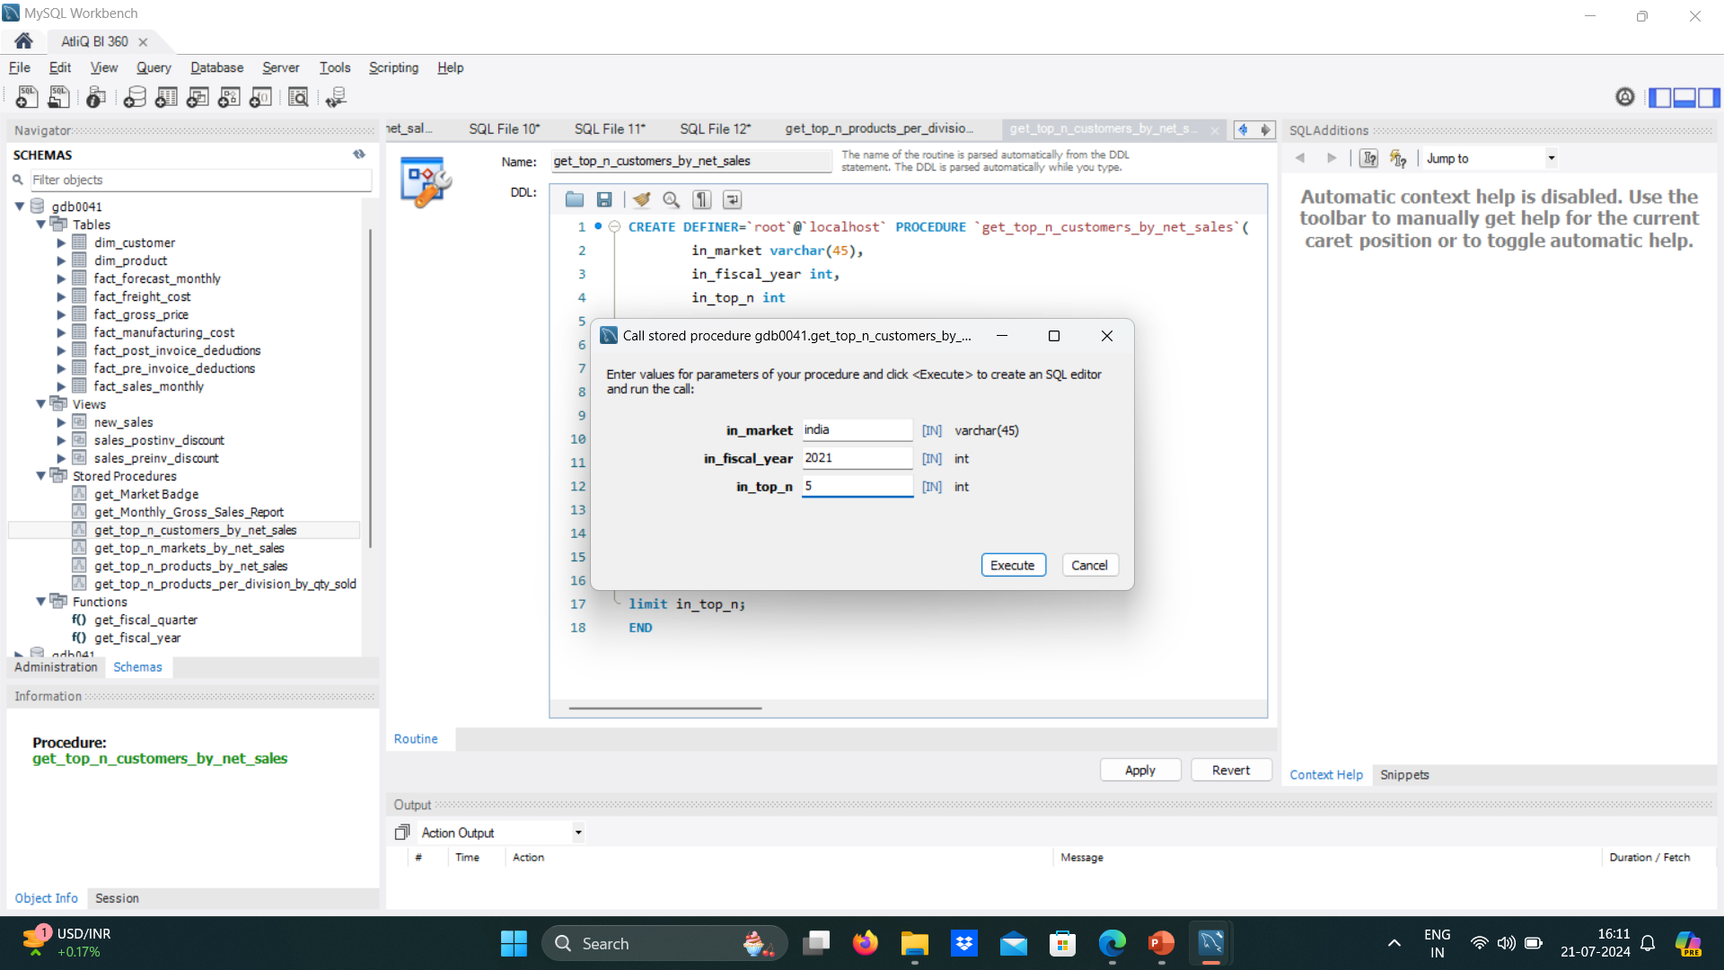


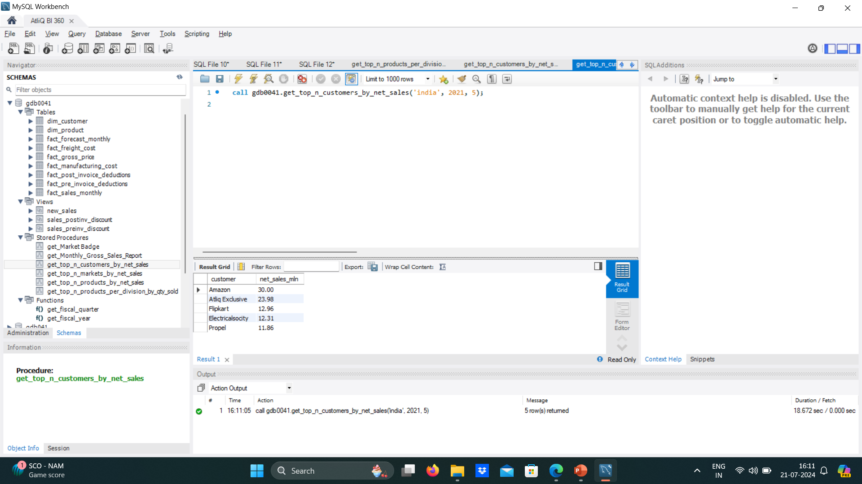
Top Customers by Net Sales

Slide 6
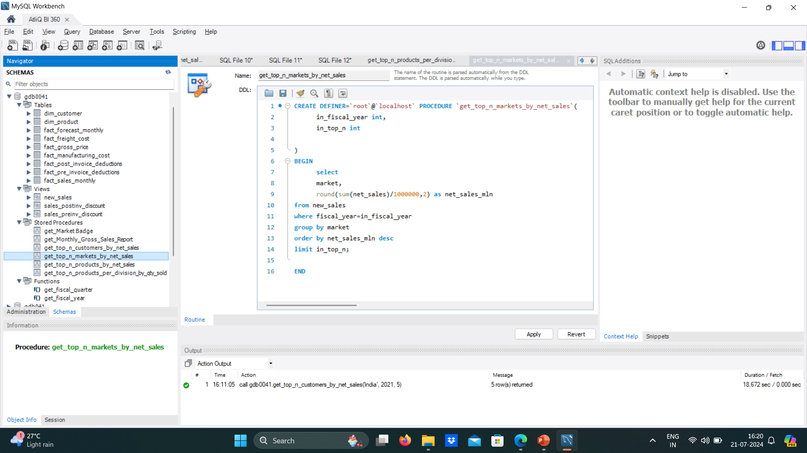
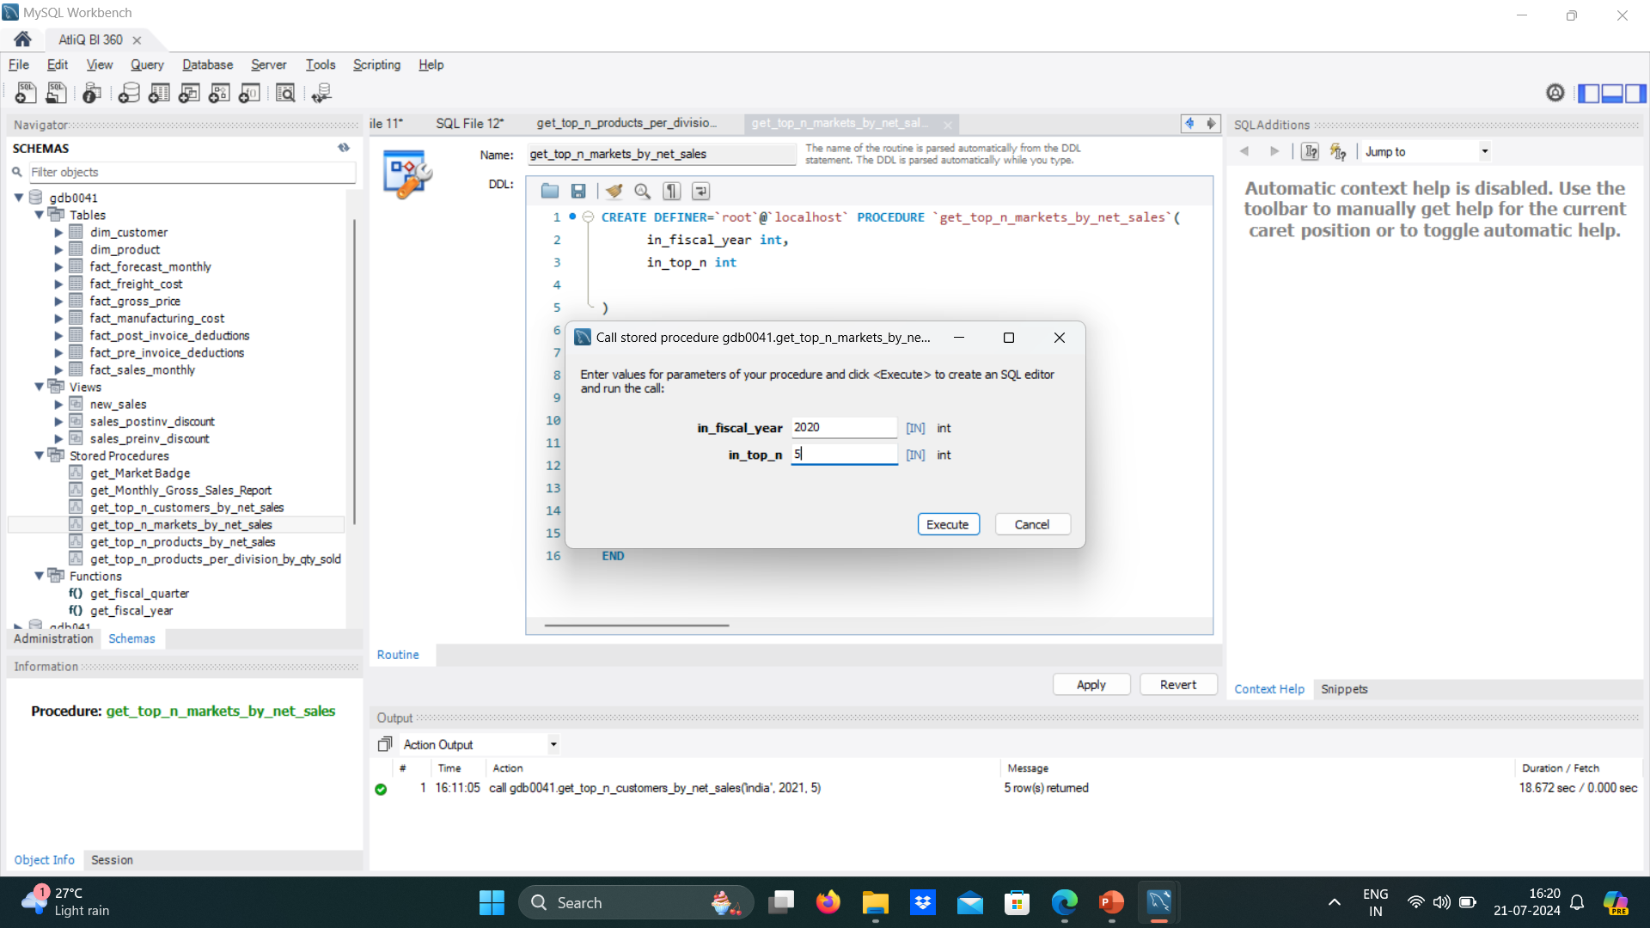
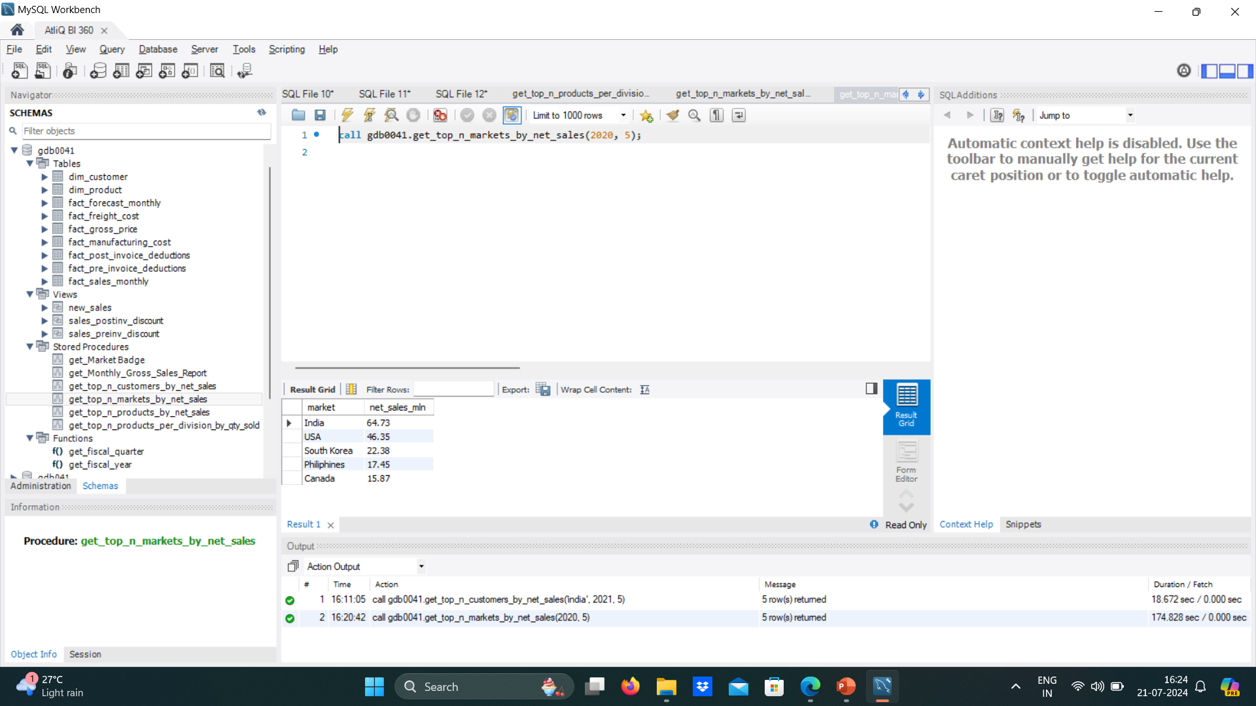
Top Markets by Net Sales

Slide 7
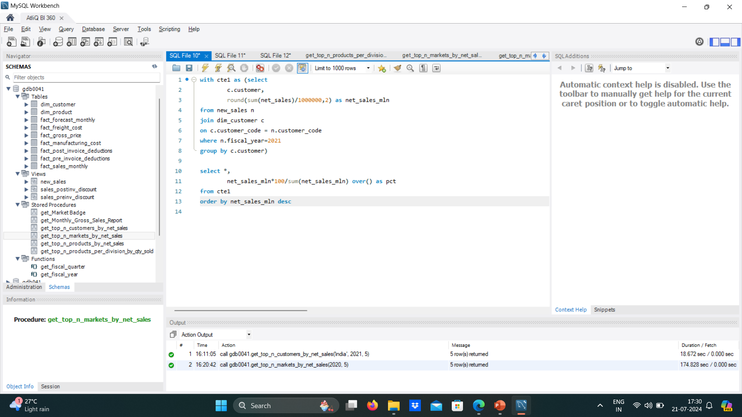
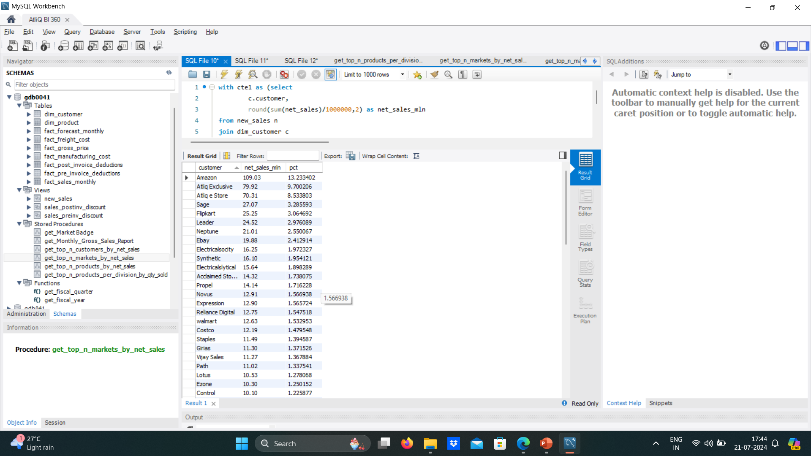
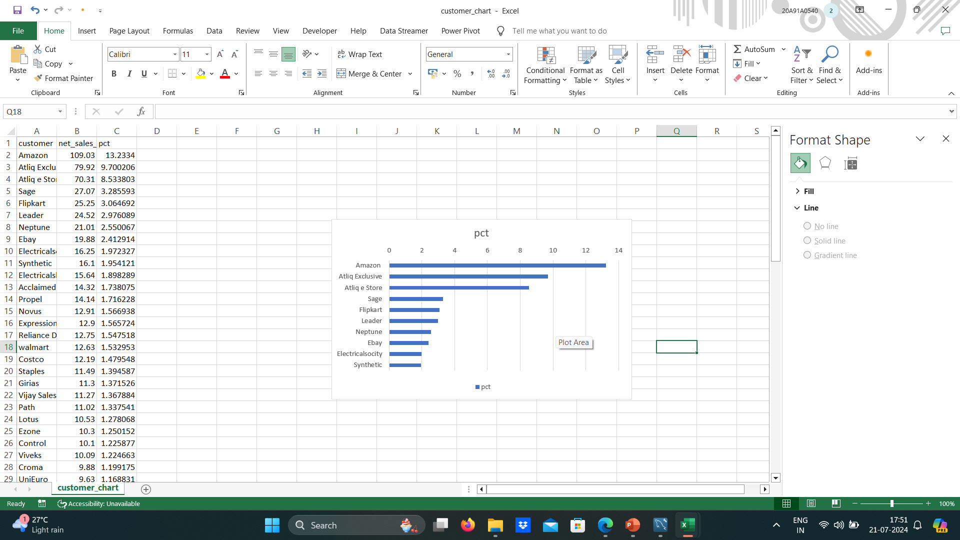

Customer Wise Net Sales Percentage contribution

Slide 8
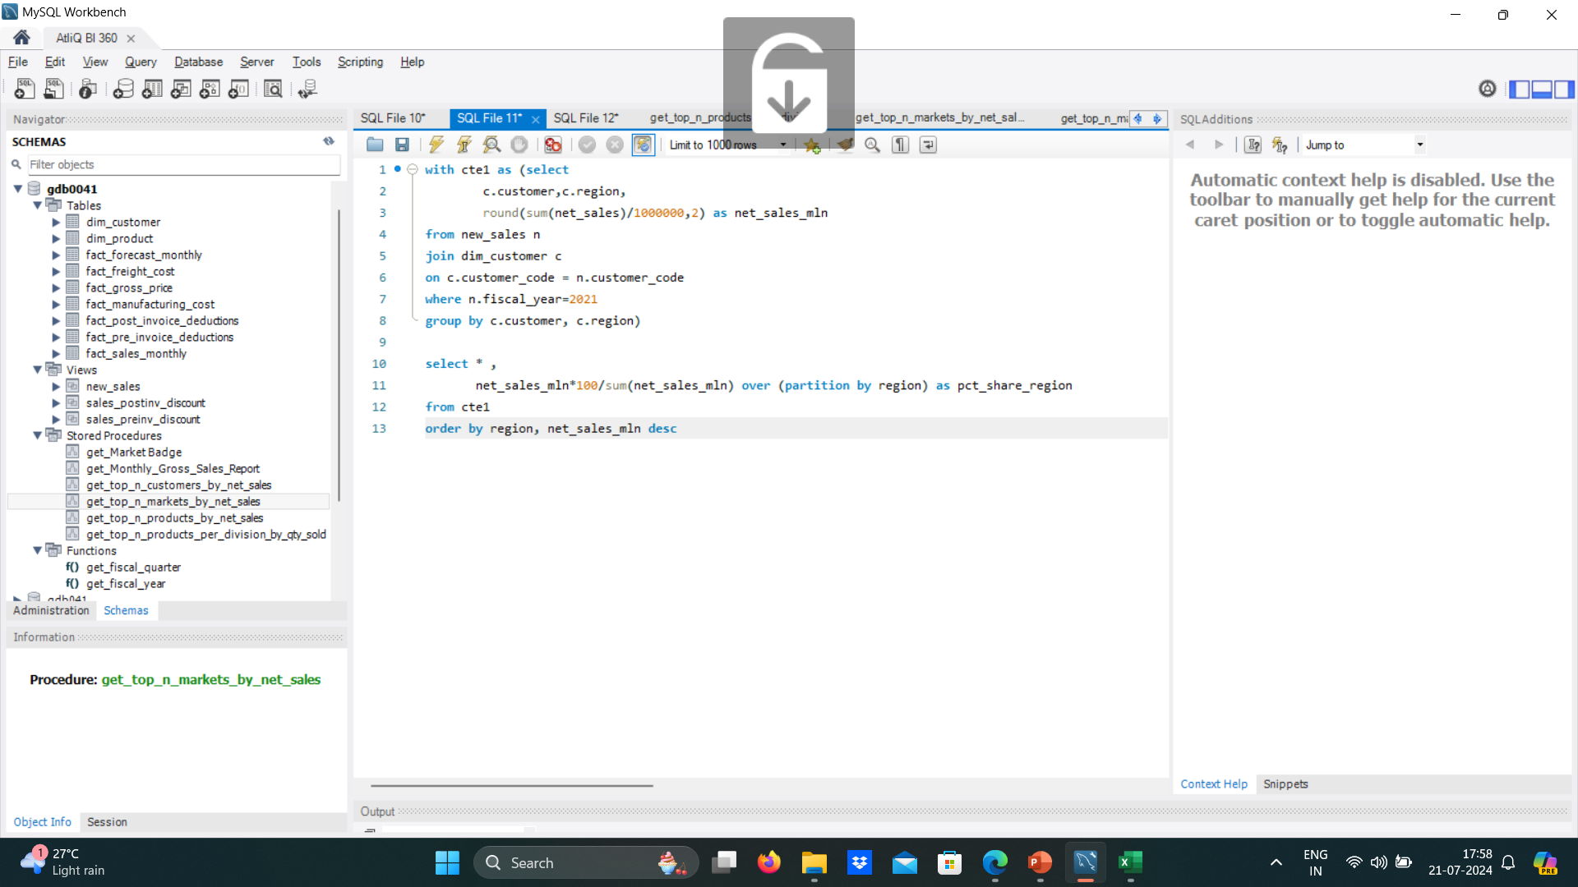
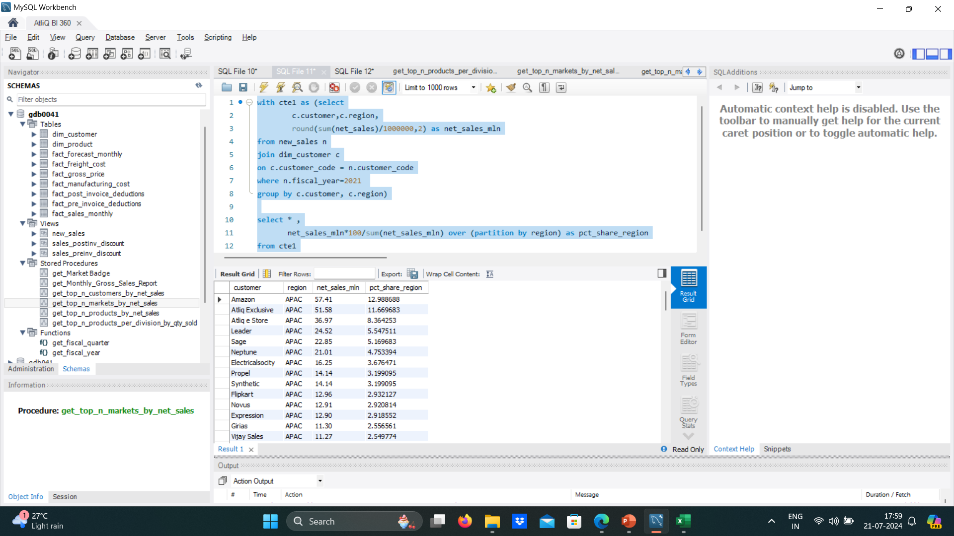
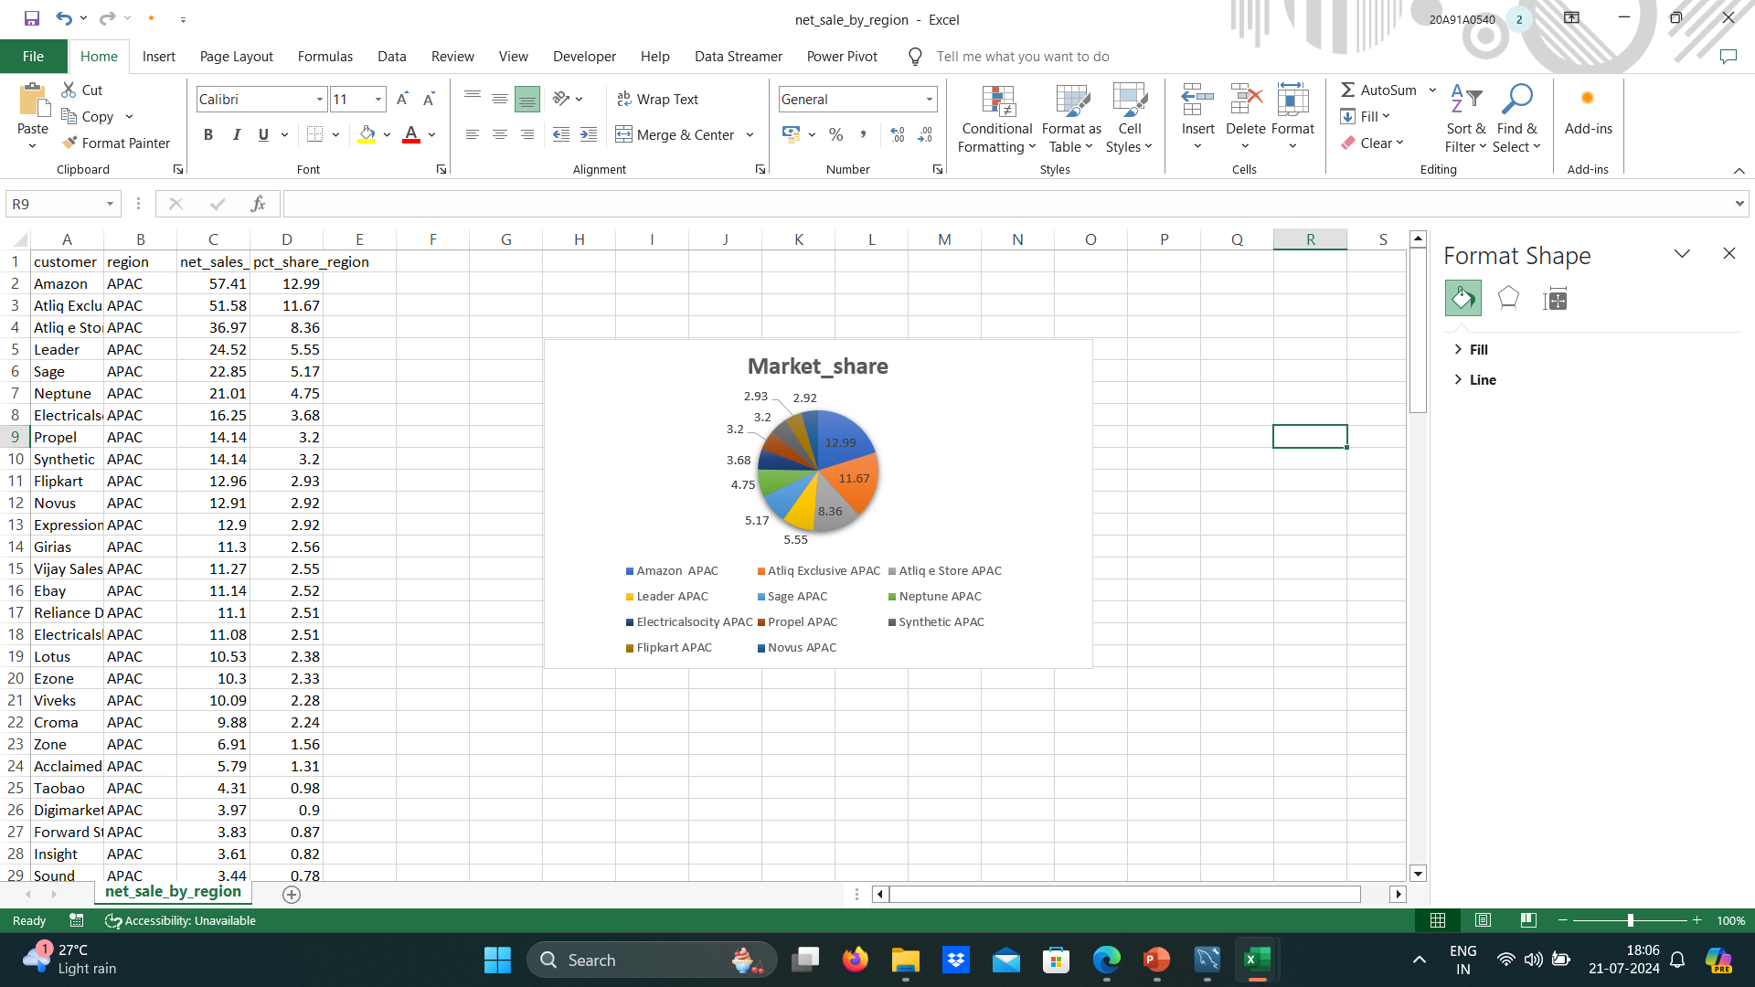
Customer Wise Net Sales Distribution Per Region For FY-2021

Slide 9
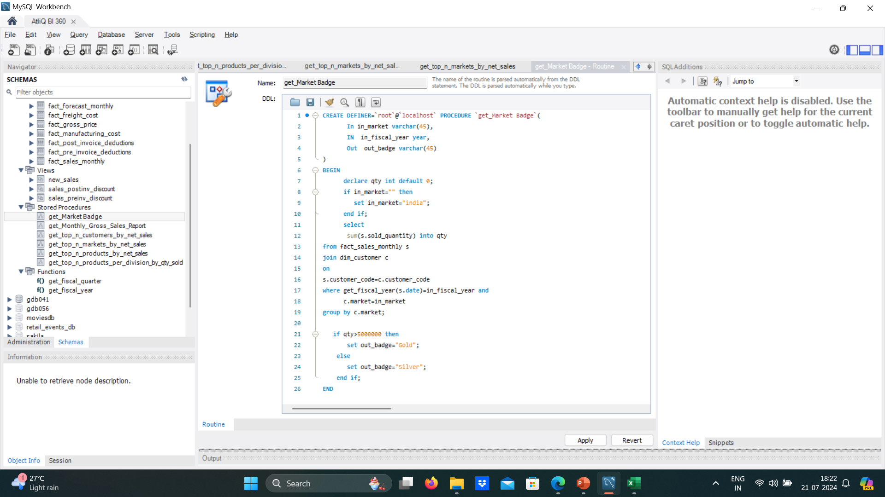
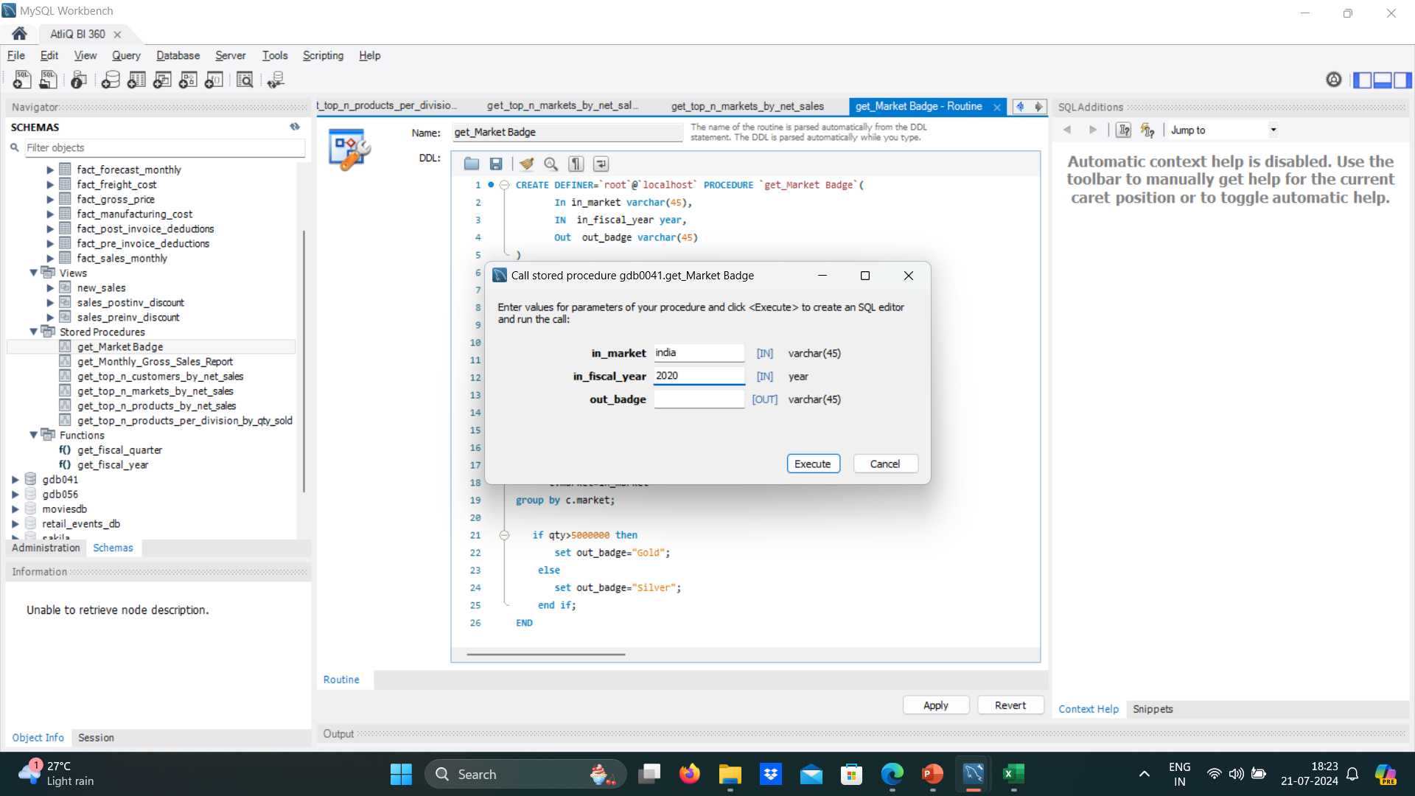
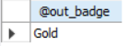
Retrieve Market Badge Weather it Falls under “Gold” or “Silver”

Slide 10
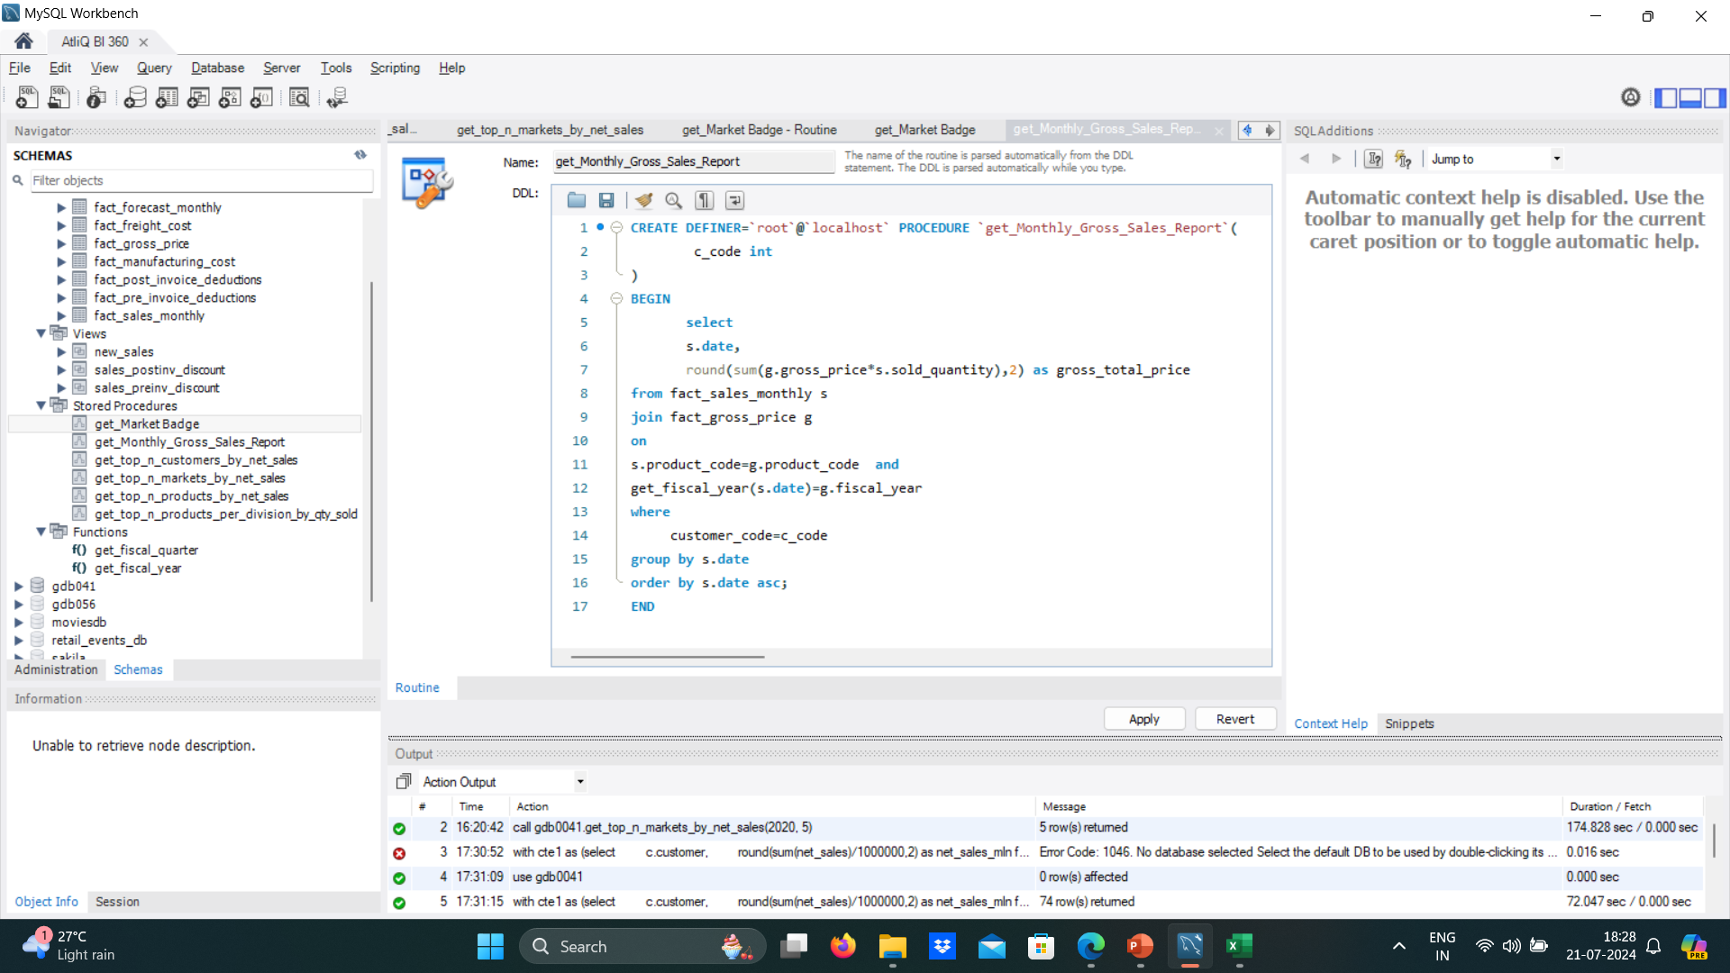
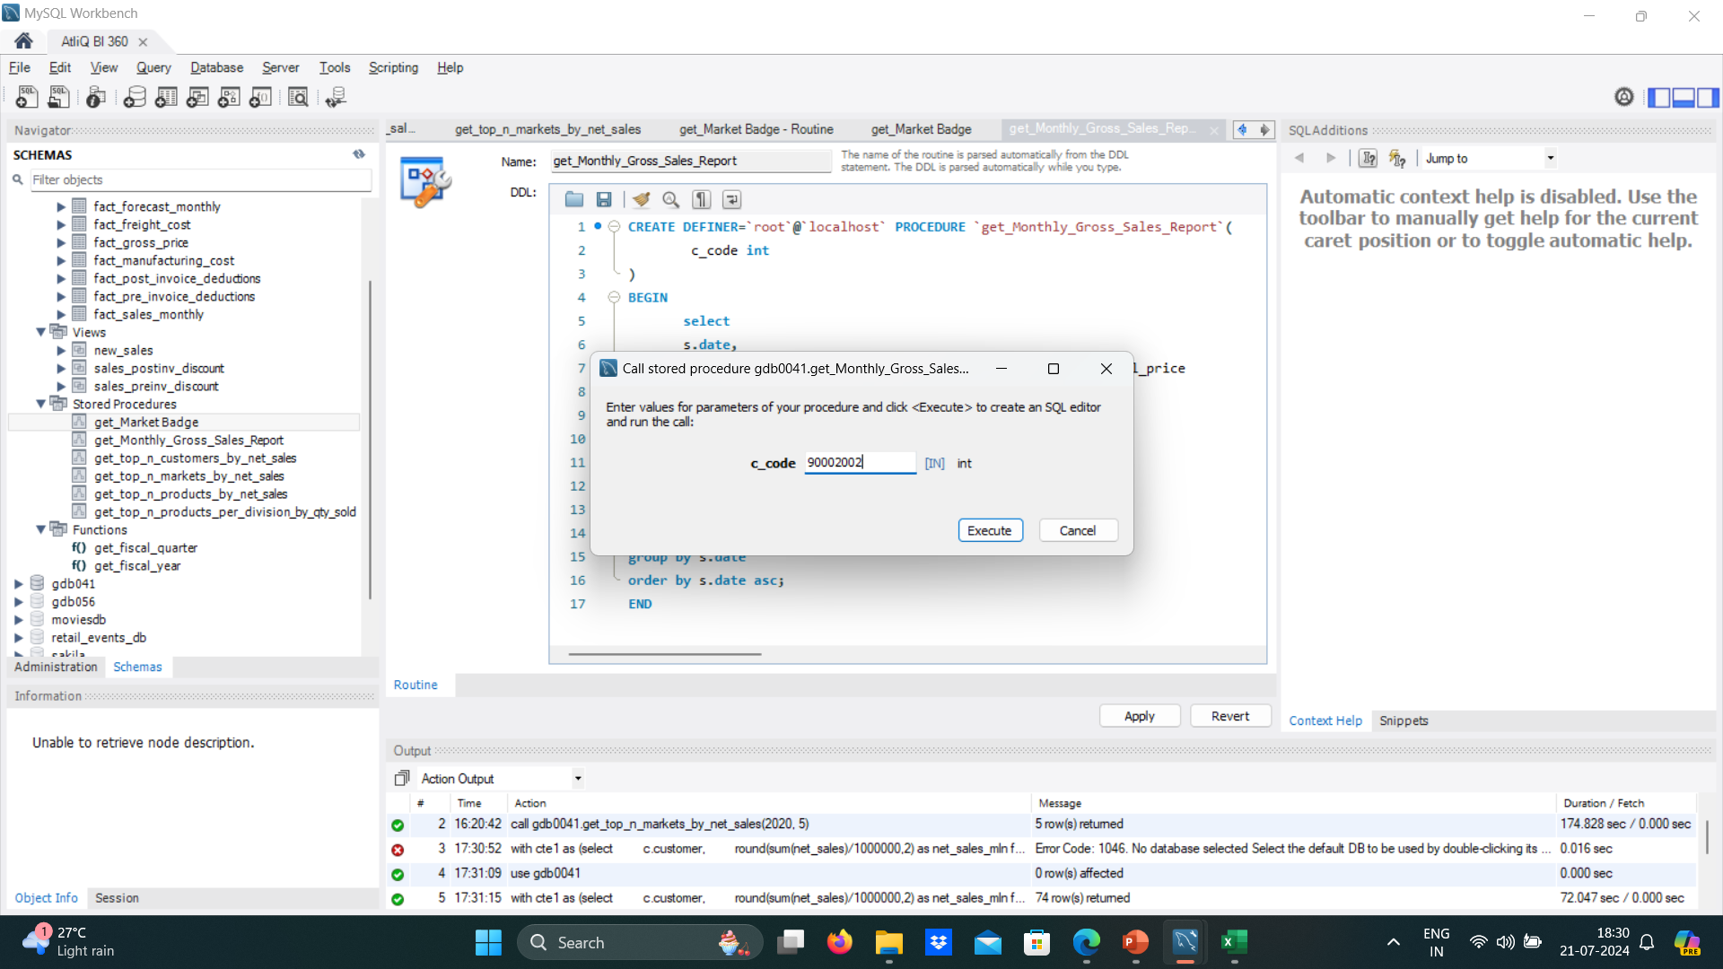

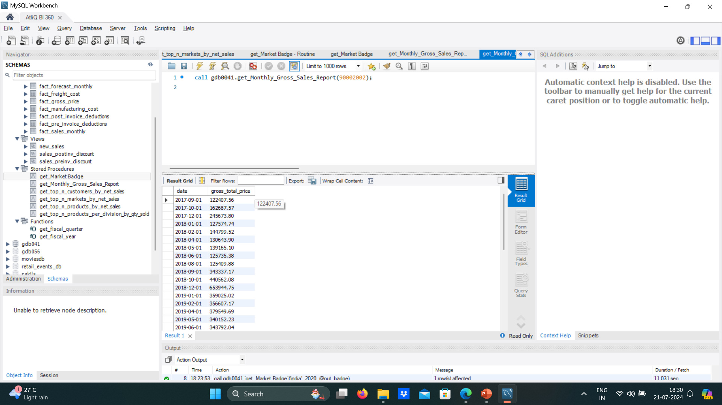
Monthly Gross Sales Report For any Customer

Slide 11
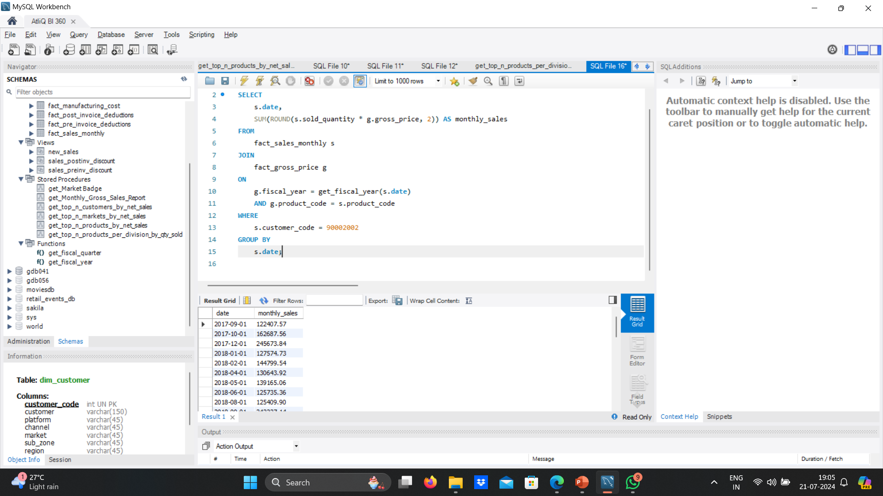
Monthly Gross Sales Report for Croma India for all these years

